Slide 1


Your 2023 Music Journey
PY

Slide 2

My Minutes Listened
18,521
Biggest listening day: May 10 with 525 minutes
PY

Slide 3






My Top Songs
1
Hey Ya!
Played for 97 mins!
2
Tere Bina
Played for 87 mins!
3
Mulaqat
Played for 82 mins!
4
Aise Kyun
Played for 77 mins!
5
Co2
Played for 70 mins!
PY

Slide 4

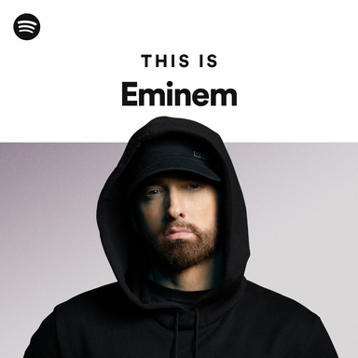
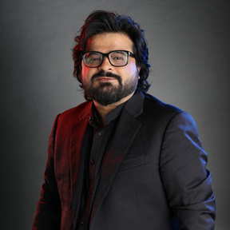

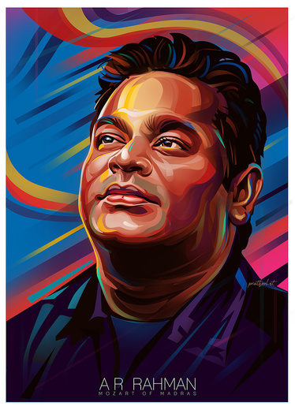

My Top Artists
1
Eminem
You gave him 862 minutes of your year.
2
Pritam
His tunes played for 682 minutes on repeat.
3
Taylor Swift
She owned 507 minutes of your time.
4
A.R. Rahman
You spent 497 minutes in his world.
5
Atif Aslam
His voice filled 481 minutes of your year.
PY

Slide 5

My Top Song
Tere Bina
A.R. Rahman
Total Streams
38
You couldn’t get enough of this one!
PY

Slide 6

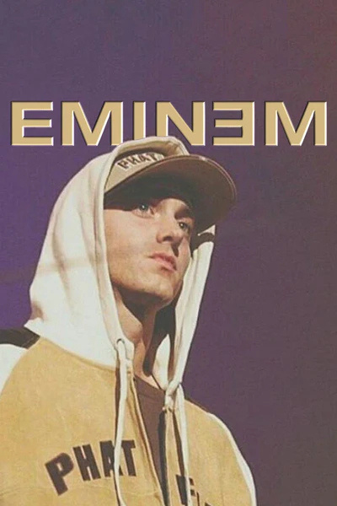
Top Artists
Top Songs
1 Eminem
2 Pritam
3 Taylor Swift
4 A.R. Rahman
5Atif Aslam
1 Sing For The Moment
2 Tu Chahiye
3 Anti-Hero
4 Nazar Laaye -Reprise
5 Jeena Jeena
Minutes Listened
18,521
PY

Slide 7

November
Your Most Musical Month
2,797 minutes of nonstop music
That’s almost 2 full days of listening!
‘जैसे सदियों से तुम मेरी जान हो’—November was all about “Mulaqat”
PY

Slide 8

You listened for
33 days
straight
The music didn’t stop, and neither did you
PY

Slide 9

Your Music Explorer Badge
The Ultimate Explorer
You discovered 3,094 new songs and explored 1,032 new artists this year!
PY

Slide 10

Your Year in Music
Here’s to the music that defined your year.
Until the next play...
PY

